Slide 1


ICUnity
Putting all the pieces together
Emma, Jacob, Luca, Ronald, Stefano, Tim

Slide 2
Hypothesis
Research question
Can we automate data mapping and feature pre-processing among clinical databases?

Slide 3


Challenges
Problems | Examples | Adressed
Different databases | MIMIC, eICU, AmsterdamUMCdb…
Multiple & different label IDs | HR, heartrate, pulse….
Different languages | Hartslag vs heartrate…
Different units | Mmol/l vs g/l….
Different sources | Blood pressure: femoral, radial, non-invasive…
Numeric vs string | 5 vs >2…
Range vs absolute values (granulartiy) | 20-30y vs 20, 21, …
Different distributions/ranges/ref ranges… | Different population vs bias
….

Slide 4
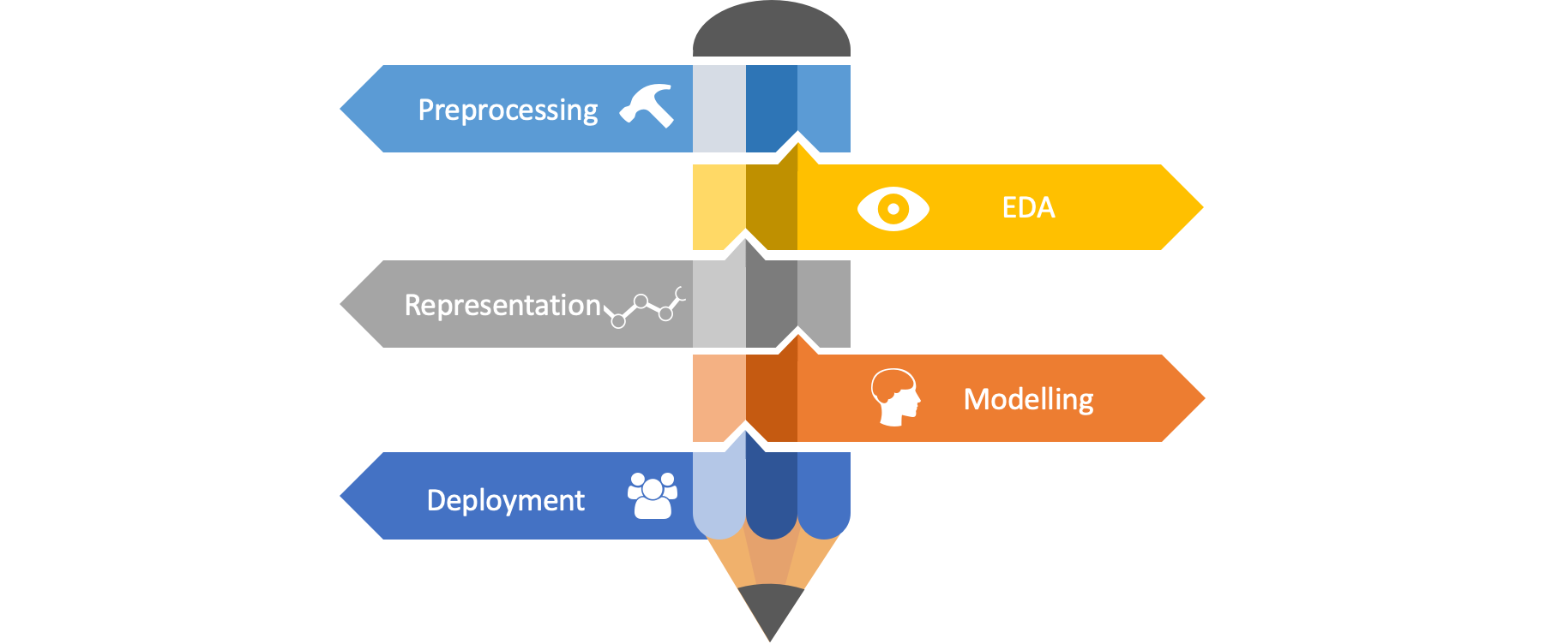
Data Science pipeline
Language normalization
Data sanity checks
Unit conversion
Data distribution visualization
Outlier detection

Slide 5
Data harmonization
Distribution
Language
Concept
‘PH’
MIMIC
Medical Ontologies
AmsterdamUMCdb
SNOMED CT
ICD10 / CIM10
MedDRA
Rxnorm / ATC
Clinical Terms Version 3

Slide 6
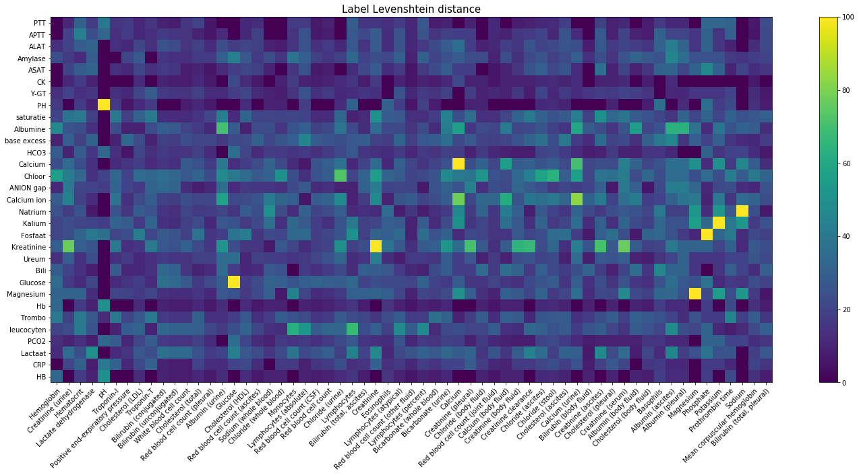
Parameter name translation and matching

Slide 7
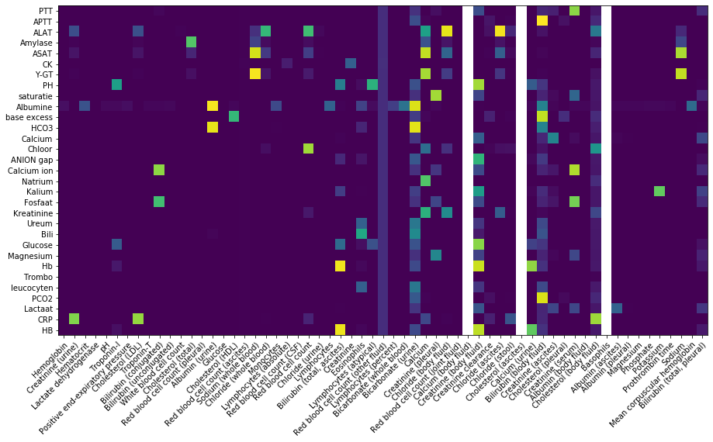
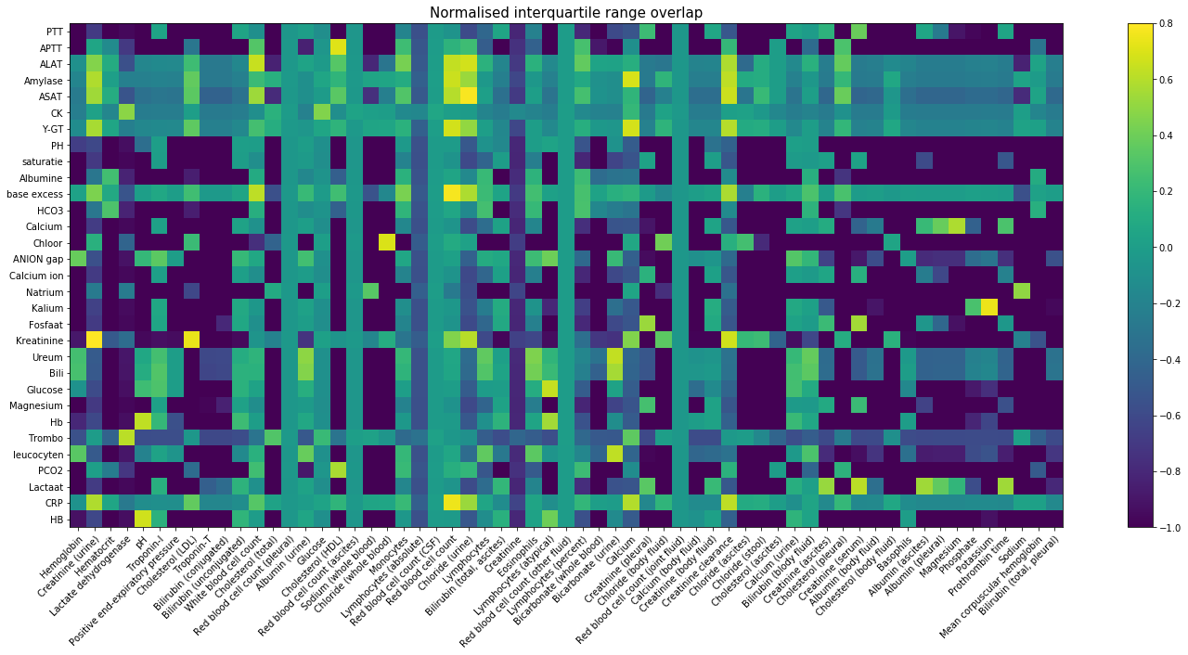
Data distribution matching
t-test
Normalized interquartile range overlap

Slide 8
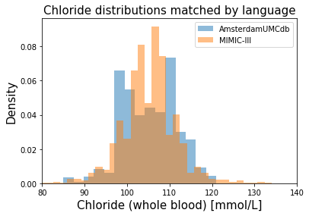
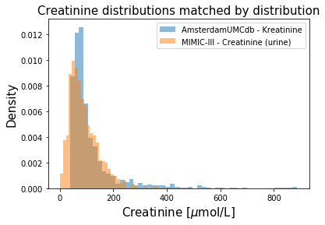
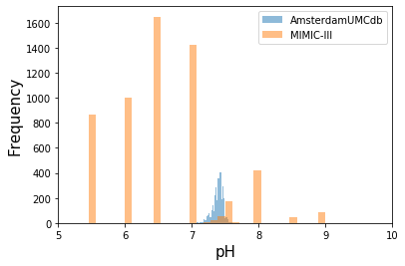
Examples

Slide 9
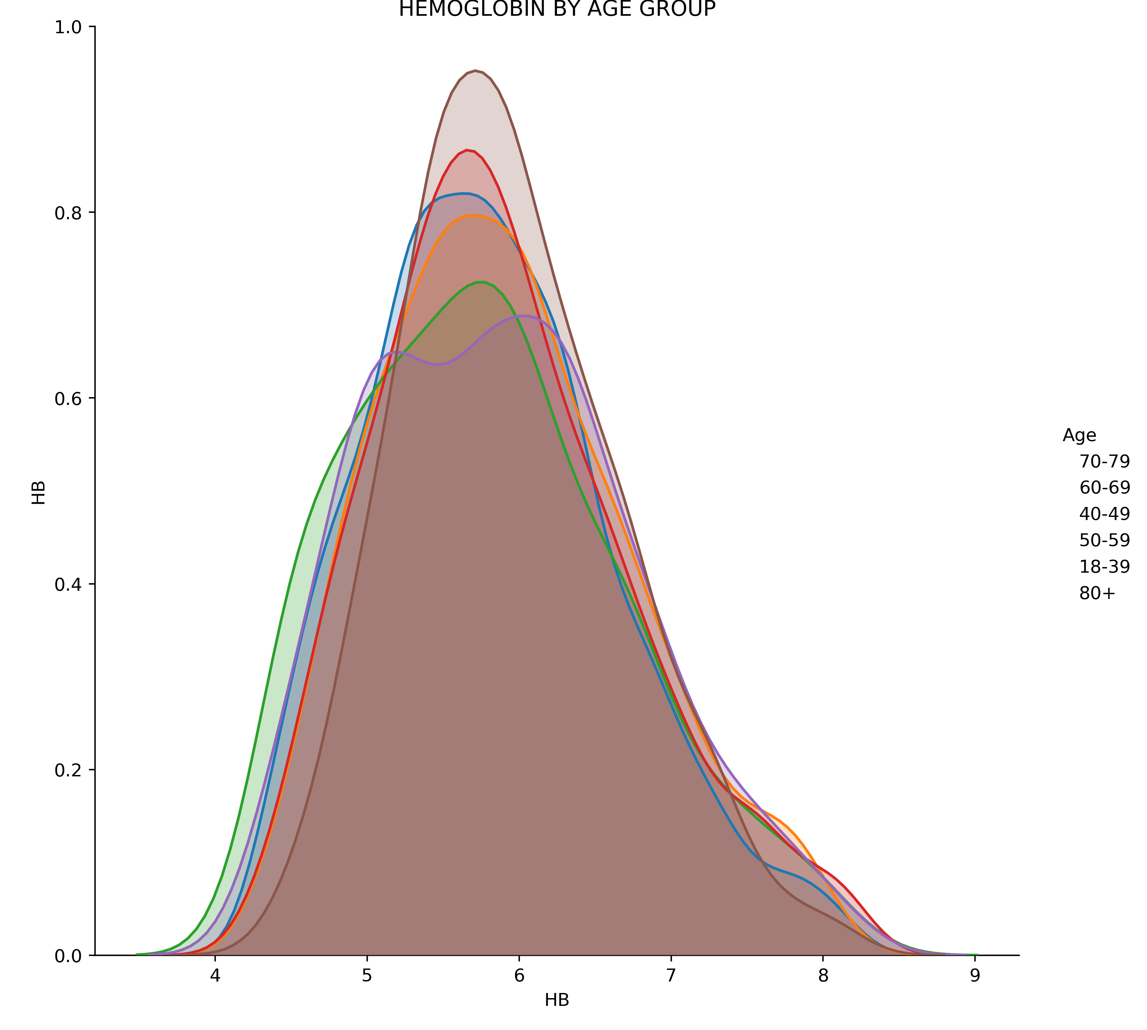
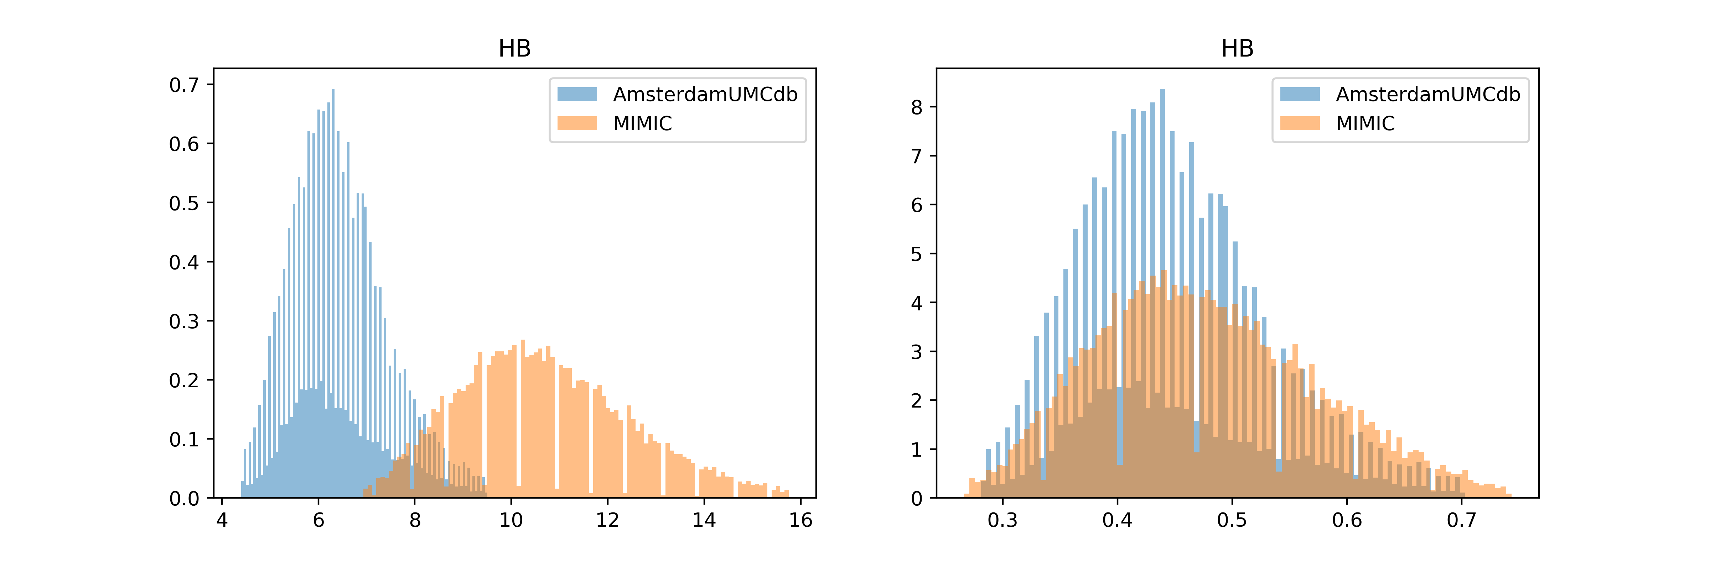
Multivariate matching
Propensity scores
Correct for comorbidities
Correct by age/gender/weight/height…
→ Automate choice of covariates
Distance matrices

Slide 10
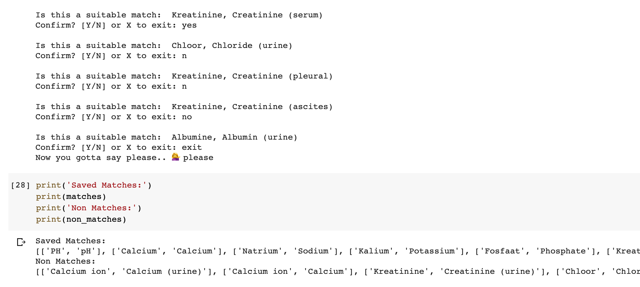
Clinical Validation Tool → Demo with Ari

Slide 11
Future development
Finetuning pipeline
Automate multivariate matching
Clinician validation
Learning language matching

Slide 12

ICUnity
Putting all the pieces together
Emma, Jacob, Luca, Ronald, Stefano, Tim

Slide 13
